Slide 1
11-791 Project
Team 07 - Team HOLa
Hao Zhang
Oleg Iskra
Lara Martin

Slide 2
Outline
Pipeline Overview
Technical Details of AEs
Answer Types
Word2Vec
Exact answers
Team Tasks
Evaluation and Statistics

Slide 3
Pipeline Overview
Reader
question
Triple
Concept
Document
Snippet
Answer
Evaluation

Slide 4
Technical Details of AEs
Concept Analysis Engine
Document Analysis Engine
Snippet Analysis Engine
Answer Analysis Engine
Triple Analysis Engine

Slide 5
Concept Analysis Engine
Web Service Used:
DiseaseOntology, GeneOntology, JochemEntities, MeshEntities, UniprotEntities
Input to Web Service API:
QueryText.replaceAll("[?.,!:;]", " ")
Output we used:
finding.getMatchedLabel() finding.getConcept().getUri() finding.getScore()

Slide 6
Concept Analysis Engine
Ranking:
Using score we get from API
concept_hitsize = 20 TypeUtil.getScoredConceptSearchResults(jcas, concept_hitsize)

Slide 7
Document Analysis Engine
Web Service Used:
Pubmed
Input to Web Service API:
QueryText.replaceAll("[?.,!:;]", " ")
Named entities in query string
MatchedLabel from ConceptSearchResult
Query text filtering with part-of-speech tagger
Output we used:
finding.getPmid() finding.getDocumentsAbstract() finding.getTitle()

Slide 8
Document Analysis Engine
ConceptSearchReseult top 5
Key Word Splicing
Pubmed
Miscarriage
Thrombophilia
thrombophilia
Risk
Miscarriage, Recurrent
miscarriage thrombophilia risk
LingPipe NER
Pubmed
Fusing
Ranking
<Empty>
Query Text
LingPipe POS
Pubmed
thrombophilia increased risk (only keep JJ, NN, NNP, RR, VVNJ)
Is thrombophilia related to increased risk of miscarriage?
RegExp Pre-process
Pubmed
is thrombophilia related to increased risk of miscarriage

Slide 9
Document Analysis Engine
Ranking:
Score(D,Q) = α・f(D.abstract,Q.text)+(1-α)・f(D.title,Q.text)
where:
f(x,y)=(<x,y>)/(|x||y|) / BM25 (hyper-params b, k1)
α = 0.5 (the value of α is IMPORTANT)
document_hitsize = 100 TypeUtil.getScoredDocument(jcas, document_hitsize)

Slide 10
Snippet Analysis Engine
Document
(Pmid + Absract)
Get Full Text?
Initialize FullText Object
Yes
No, Using abstract
Query Text
Section0
Section1
SectionN
split by line / Stanford NLP Sentence Splitting (Tokenizer)
Ranking

Slide 11
Snippet Analysis Engine
Ranking:
Standard Cosine Distance
Score(S,Q) = f(S.text,Q.text) f(x,y)=(<x,y>)/(|x||y|)
Word Expansion with WordNet
Pseudo Code for(String s : query) Set<String> s_synonyms = WordNetAPI(s); for(String t : sentence) Set<String> t_synonyms = WordNetAPI(t); if(s_synonyms ⋂ t_synonyms) update(score); //Just using Cosine Distance score = Normalize(score);
int snippet_hitsize = 50; TypeUtil.getScoredPassage(jcas, snippet_hitsize);

Slide 12
Concepts improvement
Anticipated to use Continuous Space Word Vectors Obtained by Applying Word2Vec to Abstracts of Biomedical Articles from http://bioasq.lip6.fr/tools/BioASQword2vec/

Slide 13
Word2Vec statistics
During the European project BioASQ3, word2vec was applied to more than 10M English abstracts of biomedical articles from PubMed. The resulting vectors of 1,701,632 distinct words (types) are now publicly available at http://bioasq.lip6.fr/tools/BioASQword2vec/.

Slide 14
Word2Vec obstacles
Main tool oficially available https://code.google.com/p/word2vec/ written in C++
Similar framework in Java http://deeplearning4j.org/word2vec.html uses different file formats and different approaches and ND4J computational framework (http://nd4j.org)
Hard time to integrate with existed UIMA pipeline and resolve Maven dependencies
Hard time to solve all “Out of memory” and “Heap space” errors

Slide 15
Word2Vec quality
protein: proteins, a-anchoring, pka-anchoring
thyroid: thyroidal, nonthyroid, hyperfunctioning
associated: correlated, related, correlates
hormone: gh, luetinizing, fshluteinizing
human: murine, mouse, immortalized
used: utilized, employed, applied

Slide 16
Word2Vec reality (problems)
Data file more than 3Gb needs more than 1 minute to load
Uses more than 8Gb of RAM with the peaks up to 12Gb during loading
Similar/related word search also relatively slow (approx. 800ms per query)
Between many relevant items there are at least 20% completely irrelevant.

Slide 17
Exact answers
Identified type of questions:
which, when, where, who, how, why, etc. - factoid questions
am, is, are, do, does, did, shall, will, should, would, etc. - yes/no questions
Sources:
Question Classification using Head Words and their Hypernyms, Zhiheng Huang, Marcus Thint, Zengchang Qin

Slide 18
Answering Yes/No and Factoid questions
StanfordNLP and LingPipe annotators to break question into meaningful structure
Use triples as key to question meaning (considering low triples quality)
Analysis of related concepts and documents with related keywords to identify exact answer

Slide 19
Tasks
Hao - Answer Analysis Engine
Oleg - Concept Retrieval Improvement
Lara - Evaluation

Slide 20
Evaluation
Concepts, Documents
Snippets
MAP only; GMAP not helpful

Slide 21
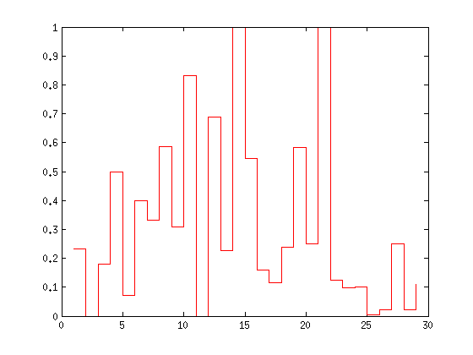
Statistics - concepts
AP
MAP: 0.3098
(from 0.1954)
Question

Slide 22
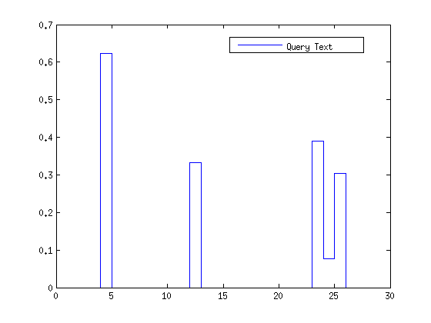
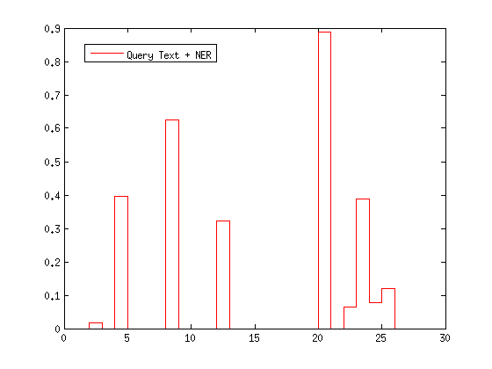
Statistics - documents
AP
AP
Question
Question
MAP: 0.0595
MAP: 0.0999

Slide 23
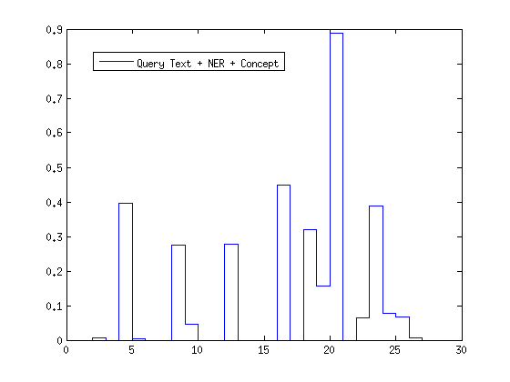
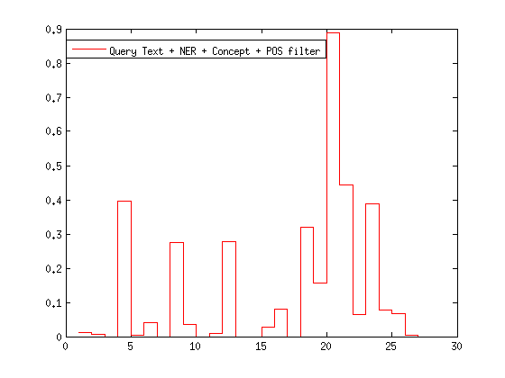
Statistics - documents
AP
AP
Question
Question
MAP: 0.1181
MAP: 0.1234
(from 0.0110)

Slide 24
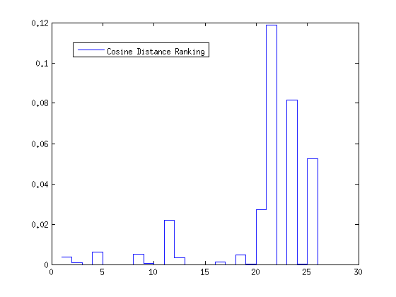
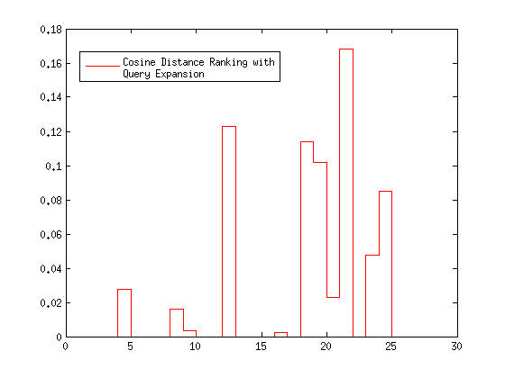
Statistics - snippets
AP
AP
Question
Question
MAP: 0.0113
MAP: 0.0245

Slide 25
Thanks

